Slide 1
SLEEP

Slide 2
New for you

Slide 3
Sleep conditions
Obstructive sleep apnea
Obesity-hypoventilation syndrome
Central sleep apnea
Complex sleep apnea
Snoring
Insomnia
Circadian rhythm disorders
Parasomnias
Somnambulism
Somniloquy
Nightmare disorder
Night terrors
Narcolepsy, Idiopathic hypersomnia
REM behavior disorder
Nocturnal seizures
Medication effects on sleep

Slide 4
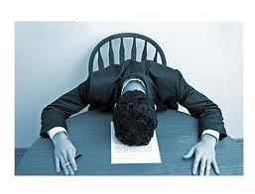
Sleep syndromes
Insomnia
Excessive daytime somnolence
Abnormal nighttime behaviors

Slide 5
Talking to patients about Sleep
Chief complaint Sleep history: Daytime sleepiness Habitual snoring Witnessed apnea/gasping/choking Difficulty falling asleep Nocturnal awakening Nocturnal movements Parasomnias Awaken refreshed AM headache Dreams Nightmares Spontaneous dropping to sleep Naps Dreaming during naps Hypnagogic/hypnopompic events | Hypertension Congestive heart failure Atrial fibrillation Diabetes mellitus Depression Tobacco Alcohol Caffeine Usual bedtime Usual wake time Work schedule Prior diagnosis of obstructive sleep apnea Treatment tried Past medical history Medications

Slide 6
Sleep Testing
Nocturnal polysomnography
CPAP titration
Home sleep testing
Autotitrating PAP
Multiple sleep latency testing
Maintenance-of-wakefulness testing
Overnight oximetry
Actigraphy
Sleep diary

Slide 7
Sleep & the rest of you
Medical diagnosis Sleep disorder
CHF Atrial fibrillation Cerebrovascular accident Diabetes mellitus Depression Asthma Hypertension Parkinson disease Obesity Depression Anxiety Schizophrenia Pregnancy Old age Chronic pain Opioid use (present or past) Post-traumatic stress disorder | Obstructive sleep apnea Central sleep apnea Complex sleep apnea Obesity-hypoventilation syndrome REM behavior disorder Insomnia Parasomnias

Slide 8
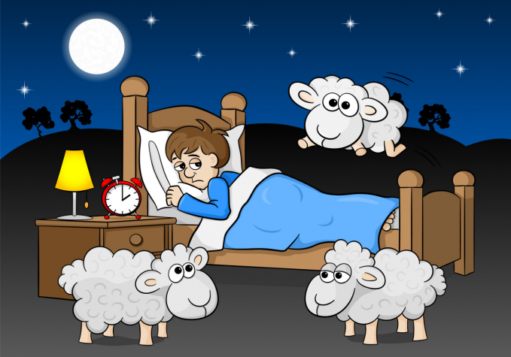
Insomnia

Slide 9
Insomnia classification
Insomnia
Chronic Insomnia Disorder
Short-Term Insomnia Disorder
Other Insomnia Disorder
Isolated Symptoms and Normal Variants
Excessive Time in Bed
Short Sleeper

Slide 10
Insomnia across the lifespan
Journal of Family Practice, January 2023
Generally useful article
Especially with respect to comments on children, pregnant patients, elders
But
A little too accepting of medications
but they do advise against melatonin!
Section on behavioral therapy for childhood insomnia is occult
It’s restless legs syndrome and it is not diagnosed by testing
Some unexplained concepts/random recommendations
Sleep diary, actigraphy, consumer sleep technology, sleep restriction therapy
Periodic limb movement disorder is probably not its own diagnosis
Short sleep is likely to be an epiphenomenon

Slide 11
Insomnia definitions
ICSD 3
2016
DSM-5
2013 (not changed in 2022 revision)
Persistent difficulty with sleep initiation, duration, consolidation, or quality that occurs despite adequate opportunity and circumstances for sleep, and results in some form of daytime impairment
A. A predominant complaint of dissatisfaction with sleep quantity or quality, associated with ≥ 1 of the following symptoms:
1. Difficulty initiating sleep.
2. Difficulty maintaining sleep, characterized by frequent awakenings or problems returning to sleep after awakenings.
3. Early-morning awakening with inability to return to sleep.
B. The sleep disturbance causes clinically significant distress or impairment in social, occupational, educational, academic, behavioral, or other important areas of functioning.

Slide 12
Insomnia definitions
ICSD 3
2016
DSM-5
2013 (not changed in 2022 revision)
Persistent difficulty with sleep initiation, duration, consolidation, or quality that occurs despite adequate opportunity and circumstances for sleep, and results in some form of daytime impairment
A. A predominant complaint of dissatisfaction with sleep quantity or quality, associated with ≥ 1 of the following symptoms:
1. Difficulty initiating sleep.
2. Difficulty maintaining sleep, characterized by frequent awakenings or problems returning to sleep after awakenings.
3. Early-morning awakening with inability to return to sleep.
B. The sleep disturbance causes clinically significant distress or impairment in social, occupational, educational, academic, behavioral, or other important areas of functioning.

Slide 13
Insomnia Subtypes ICSD 3
Chronic Insomnia Disorder
Code: F51.01
Alternate Names
Chronic insomnia
Primary insomnia
Secondary insomnia
Comorbid insomnia
Disorder of initiating and maintaining sleep
Behavioral insomnia of childhood
Sleep-onset association disorder
Limit-setting sleep disorder

Slide 14
Insomnia Subtypes ICSD 3
short-term Insomnia Disorder
Code: F51.02
Alternate Names
Acute insomnia
Adjustment insomnia

Slide 15
Insomnia Subtypes ICSD 3
Other Insomnia Disorder
Code: F51.09
Alternate Names
None! 😟

Slide 16
Isolated Symptoms and Normal Variants
Excessive Time in Bed
Without complaints
Without daytime impairment
Short Sleeper (< 6 hours)
Without complaints
Without daytime impairment

Slide 17
Insomnia in Children
Report is usually from caregiver
Bedtime resistance
Frequent nighttime awakenings
Inability to sleep independently
Daytime sequelae
Poor school performance
Impaired attention
Behavioral disturbance

Slide 18
Talking about Insomnia
Overall sleep history
Chief complaint:
Duration:
Frequency:
What disturbs sleep:
rumination?
hypervigilance?
Difficulty falling asleep?
Interrupted sleep?
Early-morning awakening?
Therapy tried:
Behavioral:
Medication:
Mood:

Slide 19
Testing In Insomnia
Rarely needed:
testing of any sort
Rule out underlying psychiatric diagnosis
Rule out obstructive sleep apnea
in selected patients
Screening measures
more useful in research settings
PSQI most helpful

Slide 20
Treating Insomnia
Preferred:
Behavioral/Psychological Treatment
Second choice:
Medication

Slide 21
levels of recommendation
Patient-care strategies from American Academy of Sleep Medicine
Standard
High degree of clinical certainty
Guideline
Moderate degree of clinical certainty
Option
Uncertain clinical use

Slide 22
Behavioral/Psychological Treatment for Insomnia
Standards Stimulus-control therapy Relaxation training CBT-I Guidelines Sleep restriction Multicomponent therapy without CBT Paradoxical intention Biofeedback | Insufficent evidence Sleep hygiene Imagery training Cognitive therapy (CBT)

Slide 23
Medication for Insomnia
Not Recommended
Should be specified as Not Recommended
Melatonin
Trazodone
Diphenhydramine
Tiagabine (Gabitril)
l-Tryptophan
Valerian
Amitriptyline
all other tricyclic antidepressants except doxepin
Hydroxyzine
Mirtazapine
Quetiapine
all other antipsychotics

Slide 24
Medication for Insomnia
If you insist …
Sleep-onset insomnia
Sleep-maintenance insomnia
Eszopiclone
Ramelteon
Zaleplon
Zolpidem
Temazepam
Please don’t!
Triazolam
Please don’t!
Eszopiclone
Doxepin
Suvorexant
Zolpidem
Temazepam
Please don’t!

Slide 25
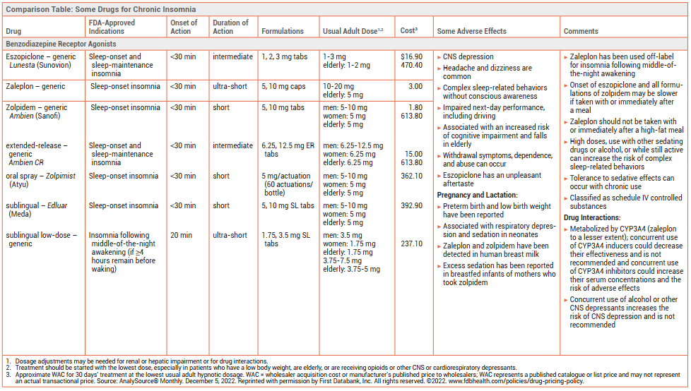
Medication for Insomnia Details
Medication | How supplied | Dose | Cost (Generic/Brand)
Z drugs
Eszopiclone (Lunesta) | 1, 2, 3 mg tabs | 1–3 mg elderly: 1–2 mg | $16.90/470.40
Zaleplon (Sonata) | 5, 10 mg caps | 10–20 mg elderly: 5 mg | 3.00
Zolpidem
Zolpidem (Ambien) | 5, 10 mg tabs | men: 5–10 mg women: 5 mg elderly 5 mg | 1.80/613.80
extended–release (Ambien CR) | 6.25, 12.5 mg ER tabs | men: 6.25–12.5 mg women: 6.25 mg elderly: 6.25 mg | 15.00/613.80
oral spray (Zolpimist) | 5 mg/actuation | men: 5–10 mg women: 5 mg elderly 5 mg | 362.10
sublingual (Edluar) | 5, 10 mg |  | 392.90
sublingual low–dose | 1.75, 3.5 mg SL tabs | men: 3.5 mg women: 1.75 mg elderly 1.75 mg | 237.10
Benzodiazepines
Temazepam (Restoril) | 7.5, 15, 22.5, 30 mg caps | 7.5–30 mg elderly: 7.5–15 mg | 79.80/885.00
Triazolam (Halcion) | 0.125, 0.25 mg tabs | 0.125–0.25 mg | 75.00/85.10
Estazolam
Flurazepam
Lorazepam
Quazepam
Tricyclic Antidepressant
Doxepin (Silenor) | 3, 6 mg tabs | 3–6 mg | 489.00/646.50
Orexin Receptor Antagonist
Suvorexant (Belsomra) | 5, 10, 15, 20 mg tabs | 10–20 mg | 509.79
Melatonin Receptor Agonist
Ramelteon (Rozerem) | 8 mg tabs | 8 mg | 365.70/466.80

Slide 26
Medication for Insomnia Details
Medication | How supplied | Dose | Cost (Generic/Brand) $
Z drugs
Eszopiclone (Lunesta) | 1, 2, 3 mg tabs | 1–3 mg elderly: 1–2 mg | 16.90/470.40
Zaleplon (Sonata) | 5, 10 mg caps | 10–20 mg elderly: 5 mg | 3.00
Zolpidem
Zolpidem (Ambien) | 5, 10 mg tabs | men: 5–10 mg women: 5 mg elderly 5 mg | 1.80/613.80
extended–release (Ambien CR) | 6.25, 12.5 mg ER tabs | men: 6.25–12.5 mg women: 6.25 mg elderly: 6.25 mg | 15.00/613.80
oral spray (Zolpimist) | 5 mg/actuation | men: 5–10 mg women: 5 mg elderly 5 mg | 362.10
sublingual (Edluar) | 5, 10 mg |  | 392.90
sublingual low–dose | 1.75, 3.5 mg SL tabs | men: 3.5 mg women: 1.75 mg elderly 1.75 mg | 237.10

Slide 27
Medication for Insomnia Details
Medication | How supplied | Dose | Cost (Generic/Brand)
Benzodiazepines
Temazepam (Restoril) | 7.5, 15, 22.5, 30 mg caps | 7.5–30 mg elderly: 7.5–15 mg | 79.80/885.00
Triazolam (Halcion) | 0.125, 0.25 mg tabs | 0.125–0.25 mg | 75.00/85.10
Estazolam
Flurazepam
Lorazepam
Quazepam
Tricyclic Antidepressant
Doxepin (Silenor) | 3, 6 mg tabs | 3–6 mg | 489.00/646.50
Orexin Receptor Antagonist
Suvorexant (Belsomra) | 5, 10, 15, 20 mg tabs | 10–20 mg | 509.79
Melatonin Receptor Agonist
Ramelteon (Rozerem) | 8 mg tabs | 8 mg | 365.70/466.80

Slide 28
Medication effects on sleep
see xlsx, docx

Slide 29
Sleep, Arousal, and emotion regulation in adolescence:
Integrating Developmental Neuroscience, Clinical Relevance, and Policy Implications
Ronald Dahl, M.D.
University of California, Berkeley

Slide 31
Nightmare Disorder

Slide 32
oral appliance therapy: problems and possibilities
Peter Cistulli, M.D., Ph.D.
Alan Lowe, DMD, Ph.D.
Todd Morgan, DMD
John Remmers, M.D.

Slide 33
REM Behavior Disorder

Slide 34
The New Treatments for RLS
How and When to Use Them

Slide 35
Sleep and Depression

Slide 36
Sleep and the Heart

