Slide 1
Journal Club
July 5, 2023
Daniel Bloch, MD FASAM
Paul Schmidt, RPh MS
Notes:
https://drblochrecovery.com/journal-club/

Slide 2
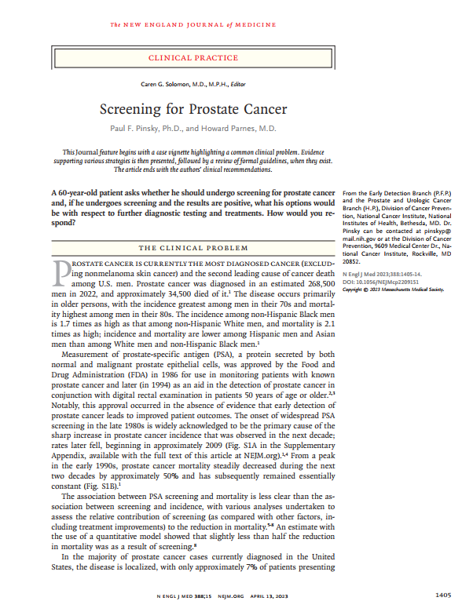
PROSTATE-CANCER SCREENING
N Engl J Med 2023;388:1405-14

Slide 3
General Screening Principles
Should we screen for everything that you can possibly screen for?

Slide 4
General Screening Principles
USPSTF rubric
Importance
Detection
Benefits of Early Detection and Treatment
Harms of Early Detection and Treatment

Slide 5
General Screening Principles
My 1997 rubric
Burden of Suffering
For the population
For the patient
Utility of the Answer
If the condition cannot be treated
100% stenosis of carotid artery
If treating the condition is fruitless
See “biases”
If treating the condition doesn’t improve outcome
Early prostate cancer
If evaluation of the screening finding is, of itself, hazardous
Thoracotomy for asymptomatic nodule on chest X-ray
If sufficient expertise in counseling and comprehensive treatment is available

Slide 6
General Screening Principles
Efficacy
Effectiveness
An efficacious test can detect the condition accurately
An effective test will favorably impact the patient’s survival or health

Slide 7
General Screening Principles
Prevalence
Incidence
Prevalence is what proportion have it now
Incidence is what proportion develop it over a period of time

Slide 8
Statistics
 | Condition Present | Condition Absent
Positive Test | true + (a) | false + (b)
Negative Test | false – (c) | true – (d)

Slide 9
Statistics: Specificity
Use a highly-specific test to rule a disease in
 | Condition Present | Condition Absent
Positive Test | true + (a) | false + (b)
Negative Test | false – (c) | true – (d)
Specificity = $\frac{TRUE –}{\left(TRUE –\right) + (FALSE +)}$
Note how numerator and denominator both lie in the “condition absent” column

Slide 10
Statistics: Sensitivity
Use a highly-sensitive test to rule a disease out
 | Condition Present | Condition Absent
Positive Test | true + (a) | false + (b)
Negative Test | false – (c) | true – (d)
Sensitivity = $\frac{TRUE +}{\left(TRUE +\right) + (FALSE −)}$
Note how numerator and denominator both lie in the “condition present” column

Slide 11
Statistics: Positive Predictive Value
If PPV is high, patient with positive test is highly likely to have the condition
 | Condition Present | Condition Absent
Positive Test | true + (a) | false + (b)
Negative Test | false – (c) | true – (d)
Positive Predictive Value = $\frac{TRUE +}{\left(TRUE +\right) + (FALSE +)}$
Note how numerator and denominator both lie in the “positive test” row

Slide 12
Statistics: Negative Predictive Value
If NPV is high, patient with negative test is highly likely not to have the condition
 | Condition Present | Condition Absent
Positive Test | true + (a) | false + (b)
Negative Test | false – (c) | true – (d)
Negative Predictive Value = $\frac{TRUE −}{\left(TRUE −\right) + (FALSE −)}$
Note how numerator and denominator both lie in the “negative test” row

Slide 13
Statistics Examples
 | Condition Present | Condition Absent
Positive Test | 25 (a) | 14 (b)
Negative Test | 18 (c) | 78 (d)
Sensitivity = $\frac{a}{a + c}=\frac{25}{43}=\text{0.58}$
Specificity = $\frac{d}{d + b}=\frac{78}{92}=\text{0.}\text{8}\text{5}$
PPV = $\frac{a}{a + b}=\frac{25}{39}=\text{0}\text{.64}$
NPV = $\frac{d}{c +d}=\frac{78}{96}=\text{0}\text{.81}$

Slide 14
Statistics Examples: Can a test be very sensitive and have a low positive predictive value?
Yes, if the disease’s prevalence in your population is very low:
 | Condition Present | Condition Absent
Positive Test | 25 (a) | 1,000,078 (b)
Negative Test | 1 (c) | 14 (d)
Sensitivity = $\frac{a}{a + c}=\frac{25}{26}=\text{0.}\text{96}$
PPV = $\frac{a}{a + b}=\frac{25}{1,000,103}=\text{0}\text{.000025}$

Slide 15
Bayes Theorem
The value of the test depends upon the prevalence of the disease in the population that you are studying
Facilitates interpreting test results by placing them in context
Example
Pick a condition whose prevalence is 1 in 10,000
Screen with a test whose false positive rate is 1%
Its specificity is approximately 99% (better than most tests)
100 false positive tests in 10,000
Presume that the test actually detects the 1 patient in 10,000 who has the condition
This gives 101 positive results, only 1 of which is in a patient with the disease
So 100 out of 101 positive results are falsely positive
So the positive predictive value is < 1%

Slide 16
Number Needed to Treat (NNT)
Example
Mortality rate without treatment: 2%
Mortality rate with treatment: 1%
Reduction in mortality: 50%
Relative risk reduction
What a great treatment!
It cuts the mortality rate in half!
Reduction in mortality: 1 percentage point
Absolute risk reduction: 1 per 100 persons treated
Number Needed to Treat: 100
What a mediocre treatment
We have to treat 100 people to save 1 life

Slide 17
Prior And Posterior Probabilities
Example
Patient with classical angina symptoms
Pretest probability of coronary artery disease: 90%
Did that help?
Another Example
Patient with totally atypical chest pain
Pretest probability of coronary artery disease: 10%
Did that help?
Treadmill electrocardiogram | Posttest probability
Negative | 85%
Positive | 95%
Treadmill electrocardiogram | Posttest probability
Negative | 5%
Positive | 15%

Slide 18
Biases Lead-Time Bias
Patient develops a disease in 1997
Patient, unscreened, develops symptoms and is diagnosed in 1999
Patient dies of disease in 2001
Patient survives 2 years with the disease
Same patient, screened, is diagnosed before symptoms develop, in 1998
Treatment is ineffective
Patient dies of disease in 2001
Patient appears to have survived 3 years with the disease
But patient’s outcome is unchanged

Slide 19
Biases Selection Bias
Patients who happen to be screened happen also to have healthier habits
Their outcomes may be better than those of the unscreened patients
This is the result of the patients’ lifestyles, not of screening

Slide 20
Biases Spectrum Bias
A test may perform differently in different groups of patients with different presentations of disease
Many classical symptoms vs. mild symptoms or atypical presentations

Slide 21
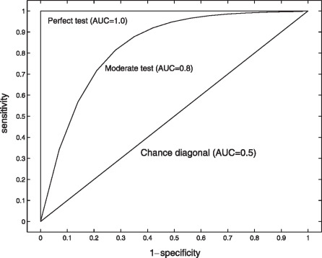
Receiver Operating Curves
You must sacrifice specificity for sensitivity, and vice versa
PSA cutoff | Sensitivity | Specificity
1.1 | 83.4 | 38.9
1.6 | 67.0 | 58.7
2.1 | 52.6 | 72.5
2.6 | 40.5 | 81.1
3.1 | 32.2 | 86.7
4.1 | 20.5 | 93.8
6.1 | 4.6 | 98.5
8.1 | 1.7 | 99.4
10.1 | 0.9 | 99.7
https://jamanetwork.com/journals/jama/fullarticle/201171

Slide 22
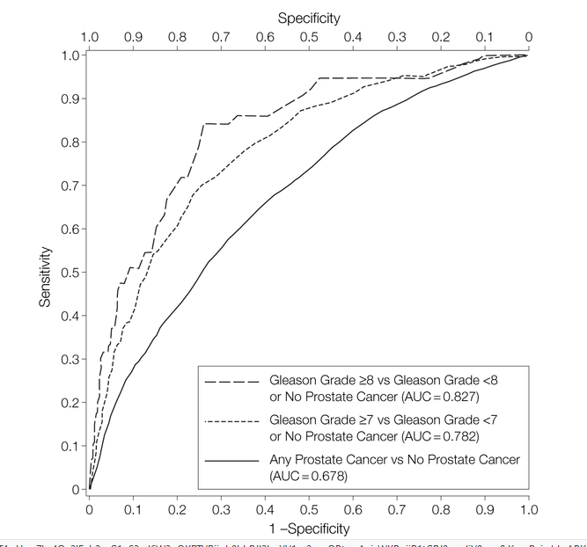
Receiver Operating Curves

Slide 23
Other prostate-cancer screening guidelines
Article’s Table 2
None of them suggests routine screening
USPSTF
“The USPSTF concludes with moderate certainty that the potential benefits of PSA-based screening for prostate cancer in men 70 years and older do not outweigh the expected harms.”

Slide 24
Shared Decision Making
Article’s Table 1
Category and Components | Details
Screening test: PSA test positivity | Approximately 8% (with 4 as the cutoff)
Cancer risk: probability of prostate cancer diagnosis after positive screen | 18% at baseline 11% at postbaseline screen (1 year after screening)
Potential benefits
Prevention of death from prostate cancer | Among 1000 men invited to undergo screening, 5 will die from prostate cancer 1.3 will avoid death from prostate cancer owing to screening (13-year period after initial screening)
Reassurance regarding low risk | In men 55 to 59 with PSA <1 0.3% cumulative risk of lethal prostate cancer (death or metastatic disease in the 15 years after screening)

Slide 25
Shared Decision Making
Potential harms
Overdiagnosis | Prostate cancer will be diagnosed in 96 of 1000 men Overdiagnosis 23 to 42% (11-year period)
Overtreatment and resulting complications | 2/3 will initially receive active treatment 1/3 will receive active surveillance of the latter, 1/2 will progress to active treatment
 | Radical prostatectomy: erectile dysfunction urinary incontinence
 | Radiotherapy: erectile dysfunction impaired bowel function
False-positive test and downstream testing | 10–15% false positive rate after 3–4 screening rounds 5% lead to negative biopsy
Biopsy complications | Bleeding Infection 1–3% risk of hospitalization

Slide 26
Shared Decision Making Personal risk
Age | Incidence (per 100,000 person-yr) | Mortality
50–64 | 253 | 9
65–74 | 735 | 54
≥ 75 | 558 | 224
Race | Incidence (Relative Risk) | Mortality (RR)
Black | 1.7 | 2.1
Non-Black | (reference) | (reference)
Family History | Incidence (Relative Risk)
Positive | 2.5
Negative | (reference)

Slide 27
Shared Decision Making
Decision-Making Factors
Attitudes and preferences: personal assessment of the importance of potential benefits and harms | Benefits: Prostate cancer ruled out Risk of dying from prostate cancer reduced
 | Harms: Treatment or periodic surveillance testing for a cancer that might never have caused any symptoms Unnecessary prostate biopsy in men without cancer
Next-step options: decisions on biopsy and treatment | Triage tests may allow the patient to avoid or defer biopsy Small risk of missing clinically significant disease
 | MRI-guided biopsy can increase detection of clinically significant disease Some risk of overdiagnosis
 | Active surveillance (periodic PSA tests and biopsies) for low-risk disease May allow the patient to avoid or defer curative treatment Small increased risk of metastatic progression or death

Slide 28
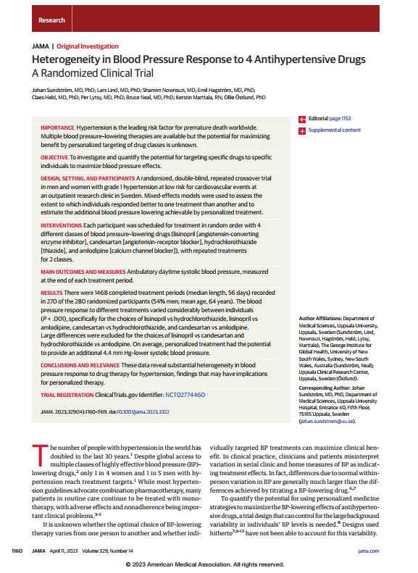
HYPERTENSION-DRUG HETEROGENEITY
JAMA 2023;329(14):1160-9

Slide 29
HYPERTENSION-DRUG HETEROGENEITY
At least as interesting for its design as for the findings

Slide 30
HYPERTENSION-DRUG HETEROGENEITY
Drugs Studied – Authors stated doses not equipotent
Name | Brand | Class | Strength (mg)
Amlodipine | Norvasc | CCB | 10
Candesartan | Atacand | ARB | 16
Hydrochlorothiazide | Hydrodiuril | Thiazide | 25
Lisinopril | Prinivil, Zestril | ACEI | 20
Notes:
Candesartan = Atacand

Slide 31
Antihypertensive Drugs
Best
Worst
Lisinopril ≈ candesartan
Hydrochlorothiazide ≈ amlodipine
Bestest
Personalized treatment
I could not understand how they decided whether 2 medications differed significantly in 1 patient,
but I did see that the homoscedasticity assumption was seen to be violated

Slide 32
Antihypertensive Drugs
Best
Worst
Lisinopril vs. amlodipine
Candesartan vs. amlodipine
Hydrochlorothiazide vs. amlodipine
Candesartan vs. lisinopril
Bestest
Personalized treatment
I could not understand how they decided whether 2 medications differed significantly in 1 patient,
but I did see that the homoscedasticity assumption was seen to be violated

Slide 33
Study Design
Population
In Sweden
54% Men, 46% Women
Measurements
24-hour blood pressure monitoring (last 24 hours of each period)
Repeated Crossover Design
Using Mixed-Effect Models
A sort of “n-of-1” testing protocol

Slide 34
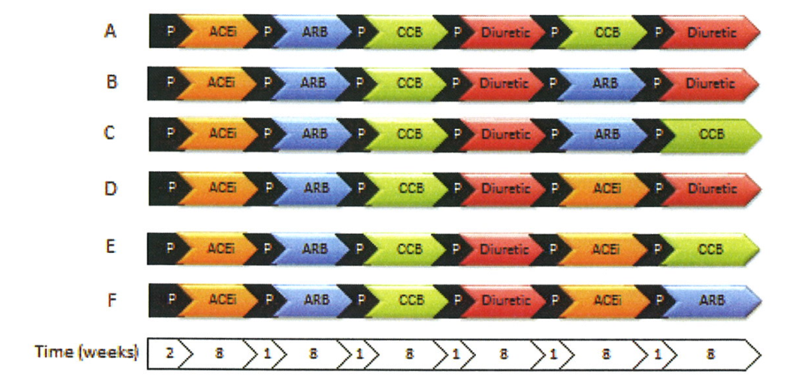
Treatment Combinations

Slide 35
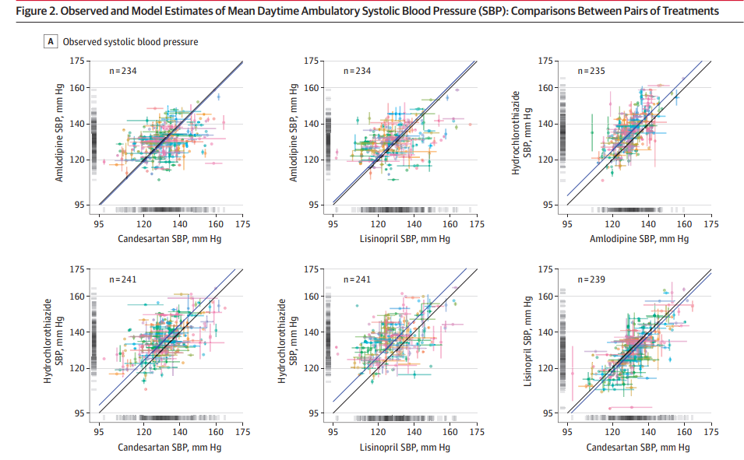
Pairwise Comparisons

Slide 36
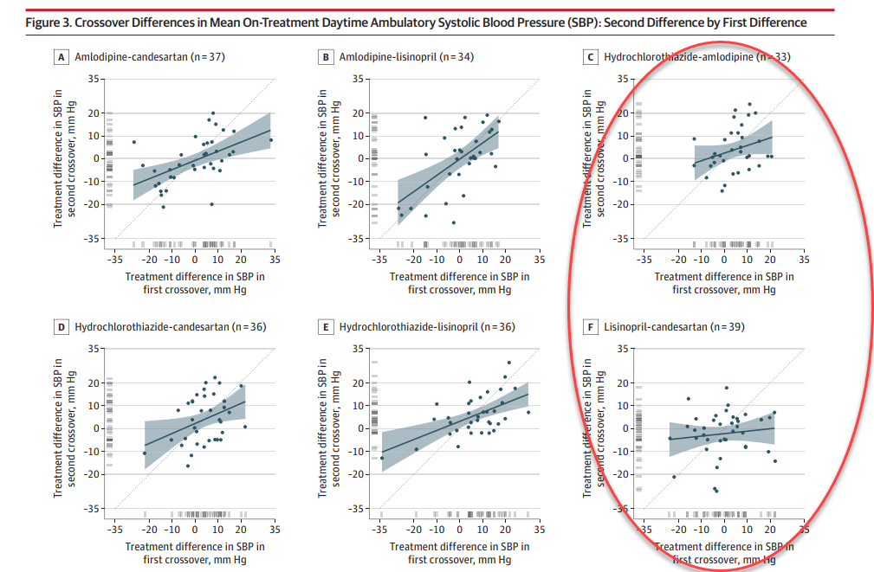
Pairwise Comparisons

