Slide 1
Hepatitis C
Daniel Bloch, MD FASAM

Slide 2



Hepatitis C
Acknowledgements
Imtiaz Alam MD
hcvguidelines.org
Go there with your cellphone, “add to home screen”

Slide 3
EPIDEMIOLOGY

Slide 4
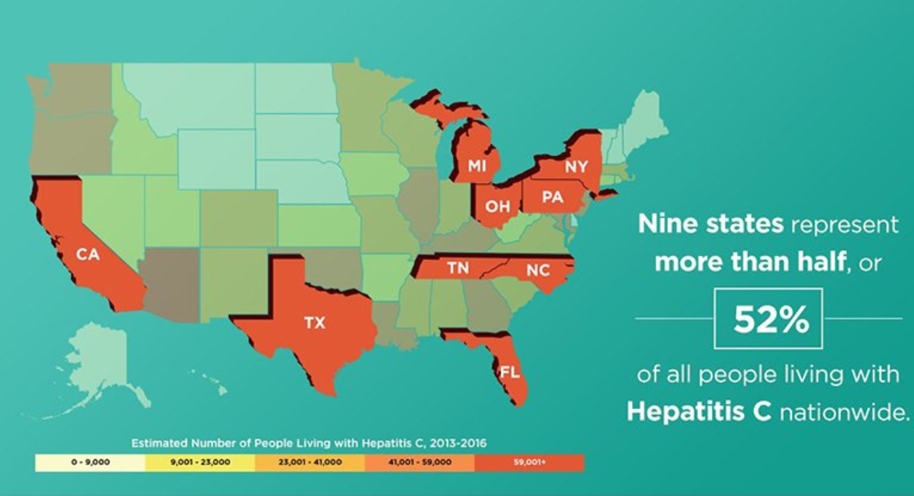
Ohio – 2013-2016, an estimated 1,000 of every 100,000 were living with hepatitis C
HepVu 2019
Notes:
Nothing more recent on HepVu

Slide 5

Current and former PWID comprise more than half of the chronic HCV population in the United States¹
~2.5
~40%
of PWID with recent
injection drug use
have HCV³
million people
are living with HCV²
~80%
of new HCV infections
in 2014 occurred
among PWID⁴
The United States has the second largest population of people with recent injection drug use who have HCV in the world: 895,000.^{3,a}
ª95% CI: 353,000-1,601,500.
1. Grebely J, et al. Clin Infect Dis. 2013;57(7):1014-1420. 2. Chhatwal J, et al. Presented at: AASLD 2018, The Liver Meeting®; November 9-13, 2018; San Francisco, CA.
3. Grebely J, et al. Addiction. 2019;114(1):150-166. 4. Zibbell JE, et al. Am J Public Health. 2018;108(2):175-181.
AASLD=American Association for the Study of Liver Diseases; CI=confidence interval.

Slide 6
Viral Infectivity of HCV and Infection Equipment
Viral infectivity of HCV persists for up to
  63 days in syringe barrel and dead space
  21 days in water in a plastic container
  14 days on inanimate surfaces (eg cookers
  and injection surfaces)
  24 hours in filter
  48 hours when foil wrapped
Meta-Analysis: Risk of HCV Seroconversion
With Sharing Injection Equipment
 | Pooled RR of HCV Seroconversion (95% CI) | Population Attributable Risk* (%)
Syringe sharing | 1.9 (1.5-2.5) | 25%
Drug cooker sharing | 2.4 (1.9-3.1) | 43%
Filtration cotton sharing | 2.6 (1.9-3.6) | 42%
Rinse water | 2.0 (1.5-2.6) | 31%
Population attributable risk represents the percentage of seroconversions that
could have been avoided if sharing was eliminated among PWID.
Doerrbecker J, et al. J Infect Dis. 2013;207:281-287.
Pouget ER, et al. Addiction. 2012;107:1057-1065.
Notes:
1 drop of infected drug can last for 63 days and remain infectious
All paraphernalia shared or used in a household of drug users.

Slide 7
HCV SCREENING

Slide 8
Recommendations for HCV Screening
(Opt out)
One-time
  Everyone age ≥ 18
  Everyone age < 18 with risk factors
With each pregnancy
Annual testing
  PWID
  MSM
    HIV-positive, unprotected
    With men taking PrEP
“Periodic” testing
  Everyone age < 18 with risk factors
United States Preventive Services Task Force

Slide 9
Risk Factors
Risk Activities
Risk Exposures
Other Factors

Slide 10
Risk Activities
Injection drug use (ever)
Intranasal drug use
Glass crack pipe use
MSM
Notes:
chem sex = intentional combining of sex with the use of particular nonprescription drugs in order to facilitate or enhance the sexual encounter

Slide 11
Risk Activities
Commercial sex
  Sex in exchange for money or drugs
Chemsex
  Sex under the influence of psychoactive substances
    Crystal methamphetamine
    Mephedrone
    GHB
    Nitrous oxide
      “Poppers”
Notes:
chem sex = intentional combining of sex with the use of particular nonprescription drugs in order to facilitate or enhance the sexual encounter

Slide 12
Risk Exposures
Long-term hemodialysis (ever)
Percutaneous/parenteral exposures in an unregulated setting
  Includes tattoos
Incarceration (ever)
Children born to HCV-infected women
Healthcare, emergency medical, and public safety workers
  After needlestick, sharps, or mucosal exposure to HCV-infected blood
Recipients of a prior transfusion or organ transplant, including persons who:
  Were notified that they received blood from a donor who later tested positive for HCV
  Received a transfusion of blood or blood components before July 1992
  Received clotting factor concentrates produced before 1987

Slide 13
Other Risk Factors
HIV infection
HBV infection
Sexually active persons about to start PrEP for HIV
Chronic liver disease and/or chronic hepatitis
  Including unexplained elevated ALT
Solid organ transplant recipients
Solid organ donors

Slide 14
HCV Diagnostic Algorithm
Vaccinate for HAV / HBV*
  More Tests:
    HCV Genotype
    FibroSure
    CBC
    Liver Function Tests
    Prothrombin Time
Anti-HCV Antibody
HCV RNA
Positive
Positive
Negative
Negative
No Further Testing
No Active Disease
TREAT!
*If patient lacks pre-existing antibodies to HAV or HBV.
Notes:
Antibody + reflex RNA (PCR)
Treatment generally “genotype agnostic” except for prior failed treatment

Slide 15
HCV Diagnostic Testing
Most Important Detail
Positive HCV-antibody test and negative HCV RNA =
No Active Hepatitis C
  (Also no protection against future infection)

Slide 16
HCV Diagnostic Testing
Details
Initial Test
  HCV Antibody with reflex quantitative RNA (by PCR)
  RNA = viral load
Recent HCV exposure (< 6 months)
  HCV-RNA or follow-up HCV-antibody testing ≥ 6 months after exposure
After previous viral clearance (spontaneous or by treatment)
  Positive HCV-antibody test is expected
  Future testing: HCV-RNA
HCV genotype testing if it might alter treatment recommendations

Slide 17
Genotype Distribution of Hepatitis C
Genotype 3 more common in PWID
GT3 is the second most common genotype worldwide, estimated to affect 54.3 million people globally
In the US, 12% of chronic HCV patients are GT3, the third largest population
*Subjects with genotype 1 and undetermined subtype.
17

Slide 18
HCV GT3 Infection Has a Unique Pathophysiology
Burden of disease
More steatosis
Increased risk for HCC
Lower response to available therapies
Higher risk for late-stage liver events
Higher mortality
Accelerated fibrosis
Compared with GT 1
HCC=hepatocellular carcinoma

Slide 19
NATURAL HISTORY

Slide 20
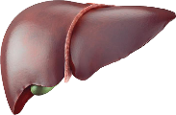
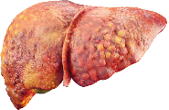

Chronic HCV infection can
lead to cirrhosis and
increase the risk for HCC
DECOMPENSATED CIRRHOSIS
≤30%
AT 10 YEARS
HCC
1%- 4%
PER YEAR
ACUTE INFECTION
CHRONIC INFECTION
CIRRHOSIS
(within the first 20 years)
75%- 85^{%b}
10%- 20%
15%- 25^{%b}
Clearance of HCV RNA
Potential extrahepatic manifestations
Initiating treatment in patients with little to no liver disease rather than in those with advanced liver disease can lead to improved long-term survival in patients with HCV.
HCC=hepatocellular carcinoma
Notes:
20%-30% of individuals are symptomatic

Slide 21
Select Host Factors Associated With
More Rapid Disease Progression
Nonmodifiable Host Factors
Older age at infection | Accelerated cirrhosis development
Longer duration of infection | Accelerated fibrosis progression
Hispanic ethnicity | Higher mortality rate from HCV-related cirrhosis Higher mortality rate from HCC
Genetic factors | African Americans have lower histologic activity and incidence of liver cirrhosis than Caucasians
Behavioral and Clinical/Laboratory Host Factors
Increased severity of alcohol use | Increased risk of advanced hepatic fibrosis Increased viral load
Combined obesity and diabetes mellitus | HCC RR 100
↑ AST : ALT ratio ↑ bilirubin ↓ albumin ↓ platelet count | Independent predictors of fibrosis progression or clinical decompensation
Genotype 3 | Increased risk of cirrhosis and HCC
HIV-1 co-infection | Higher viral load, rapid progression to cirrhosis, liver failure, and HCC
HBV co-infection | Increased risk of HCC

Slide 22
Presenting Symptoms
20-30% of patients are asymptomatic, even in late infection
Symptoms may include
Fever
Fatigue
Loss of appetite
Nausea
Vomiting
Abdominal pain
Dark urine
Grey-colored stools
Jaundice
Joint pain
First symptoms may be those of extrahepatic manifestations

Slide 23
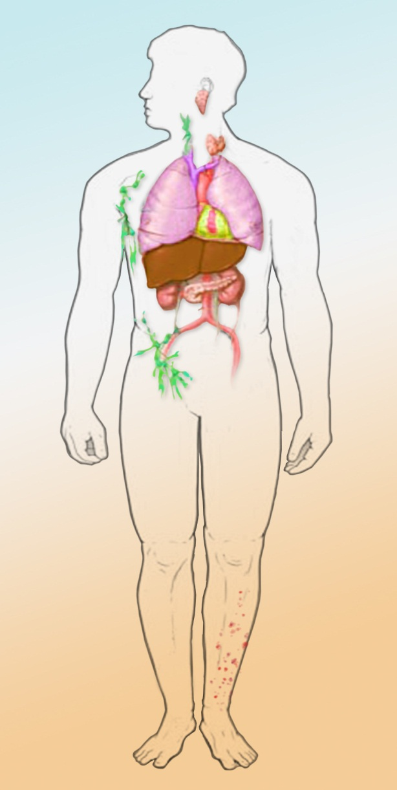
Extrahepatic Manifestations of HCV
Strongly associated
Possibly associated
  Mixed cryoglobulinemia
  Sicca syndrome
  Lymphoproliferative disorders
  Porphyria cutanea tarda
  Neuropathy
  Membranoproliferative glomerulonephritis
  Cryoglobulinemic vasculitis
  Corneal ulcers
  Thyroid disease
  Lichen planus
  Pulmonary fibrosis
  Type 2 diabetes
  Systemic vasculitis
  Arthralgias, myalgias, inflammatory polyarthritis
  Autoimmune thrombocytopenia

Slide 24
Invasive and Noninvasive Fibrosis Tests
Liver Biopsy
Serum Markers
  APRI
  FibroSURE
  ELF
Transient (Ultrasound) Elastography
MR Elastography

Slide 25
FibroSURE
LabCorp test # 550123
Test Components
  ALT
  GGT
  Bilirubin
  α2-macroglobulin
  Apolipoprotein A1
  Haptoglobin
  Patient's age and sex
Fibrosis Stage | Description | Range
F0 | No fibrosis | < 0.21
F0-F1 |  | 0.21-0.27
F1 | Portal fibrosis | 0.27-0.31
F1-F2 |  | 0.31-0.48
F2 | Bridging fibrosis with few septa | 0.48-0.58
F3 | Bridging fibrosis with many septa | 0.58-0.72
F3-F4 |  | 0.72-0.74
F4 | Cirrhosis | > 0.74 (maximum 1.00)

Slide 26
FibroSURE
LabCorp test # 550123
Test Components
  ALT
  GGT
  Bilirubin
  α2-macroglobulin
  Apolipoprotein A1
  Haptoglobin
  Patient's age and sex
Inflammation Stage | Description | Range
F0 | No fibrosis | < 0.21
F0-F1 |  | 0.21-0.27
F1 | Portal fibrosis | 0.27-0.31
F1-F2 |  | 0.31-0.48
F2 | Bridging fibrosis with few septa | 0.48-0.58
F3 | Bridging fibrosis with many septa | 0.58-0.72
F3-F4 |  | 0.72-0.74
F4 | Cirrhosis | > 0.74 (maximum 1.00)

Slide 27
Counseling HCV-Infected Patients:
Minimizing Disease Progression
Avoid alcohol
Vaccines
  HAV
  HBV
  Pneumococcal vaccine if cirrhosis
Treatment!

Slide 28
Counseling HCV-Infected Patients:
Avoiding Transmission
Avoid Sharing
  Toothbrushes, Water-Piks
  Shaving equipment
  Drug paraphernalia
Avoid Using
  If you use, clean the injection site with a new alcohol swab and dispose of syringes and needles after one use in a safe, puncture-proof container
Bandage bleeding wounds
Do not donate blood, body organs, other tissue or semen
Safe sexual practices
  Barrier protection for HIV-positive MSM and those with multiple sexual partners or STIs
  (For others with HCV infection, the risk of sexual transmission of HCV is low)

Slide 29



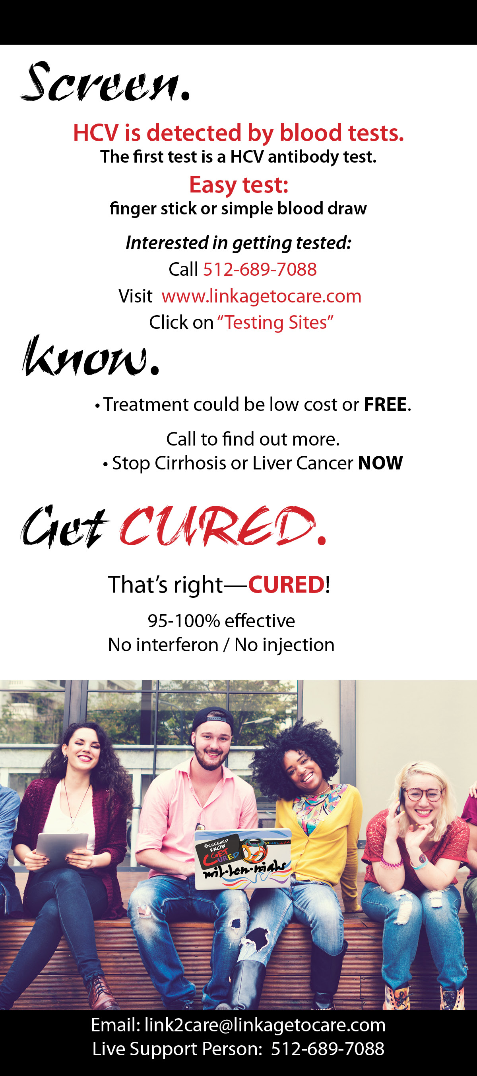
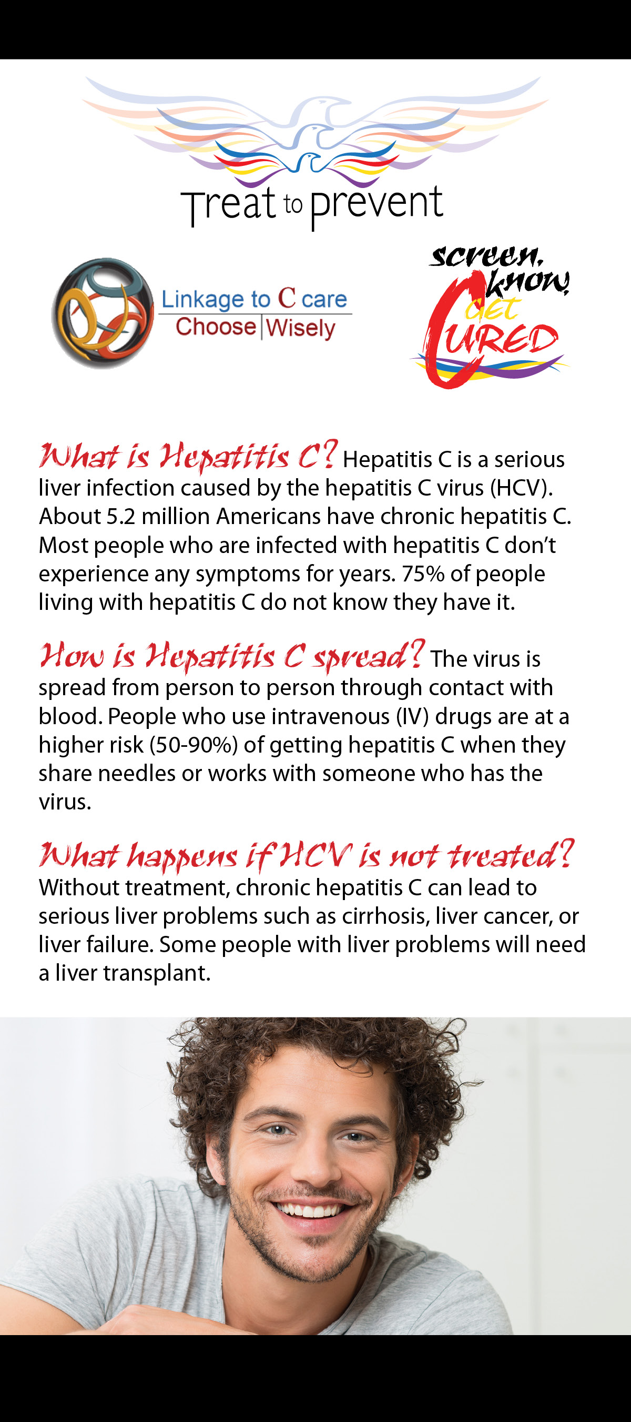
Educational Materials

Slide 30
TREATMENT

Slide 31
Treatment Goal in HCV Is SVR
SVR = HCV RNA negative (by a sensitive assay, <15 IU/mL) at
12 weeks after cessation of treatment
OK to say “cured”
Majority of patients who achieve an SVR do not experience viral recurrence
You can catch hepatitis C again

Slide 32
Nearly Everyone With HCV Can Now Be Treated Successfully
Very high SVR rates; therapies highly tolerable
All-oral therapy for every patient
Treatment generally just 8-12 weeks
Direct-Acting Antivirals
All-Oral Therapy
Peginterferon
2013
Current
100
2011
90+
95+
Standard
Interferon
Ribavirin
80
2001
70+
60
1998
SVR (%)
55
1991
42
40
34
39
20
16
6
0
IFN
6 Mos
IFN
12 Mos
IFN/RBV
6 Mos
IFN/RBV
12 Mos
PegIFN
12 Mos
PegIFN/ RBV
12 Mos
PegIFN/
RBV +
DAA
DAA +
RBV ± PegIFN
All–Oral
DAA±
RBV

Slide 33

Current All-Oral Regimens
Single-pill formulations or 2-3-pill combinations
Combination | Brand Name
Sofosbuvir/velpatasvir | Epclusa
Glecaprevir/pibrentasvir | Mavyret Abbvie
Sofosbuvir/velpatasvir/voxilaprevir | Vosevi Gilead
Grazoprevir/elbasvir
Ombitasvir/paritaprevir/ritonavir
Ombitasvir/paritaprevir/ritonavir + dasabuvir
Sofosbuvir + daclatasvir
Sofosbuvir/ledipasvir
Simeprevir + sofosbuvir
Effective for all genotypes

Slide 34
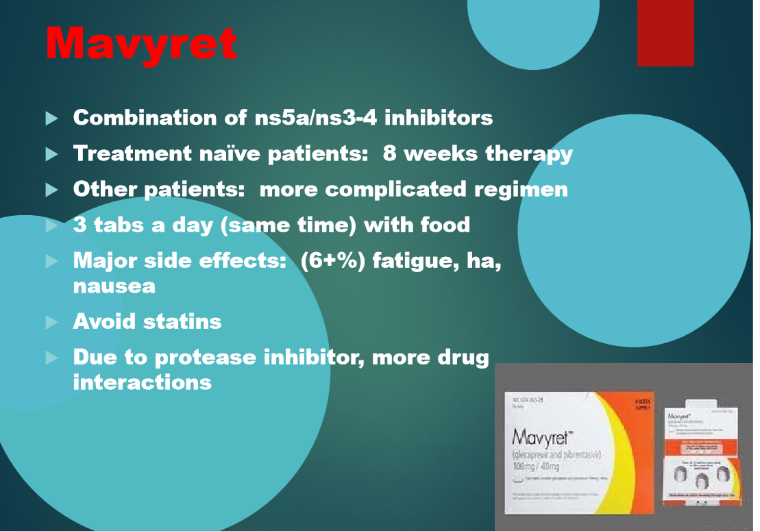
Glecaprevir/Pibrentasvir
GT1-6
No cirrhosis: 8 wks
Compensated cirrhosis: 12 wks
Drug-Drug Interactions
Statins
Oral contraceptives with EE
Anticonvulsants
Cyclosporine
Digoxin
Various herbals
Rifampin

Slide 35
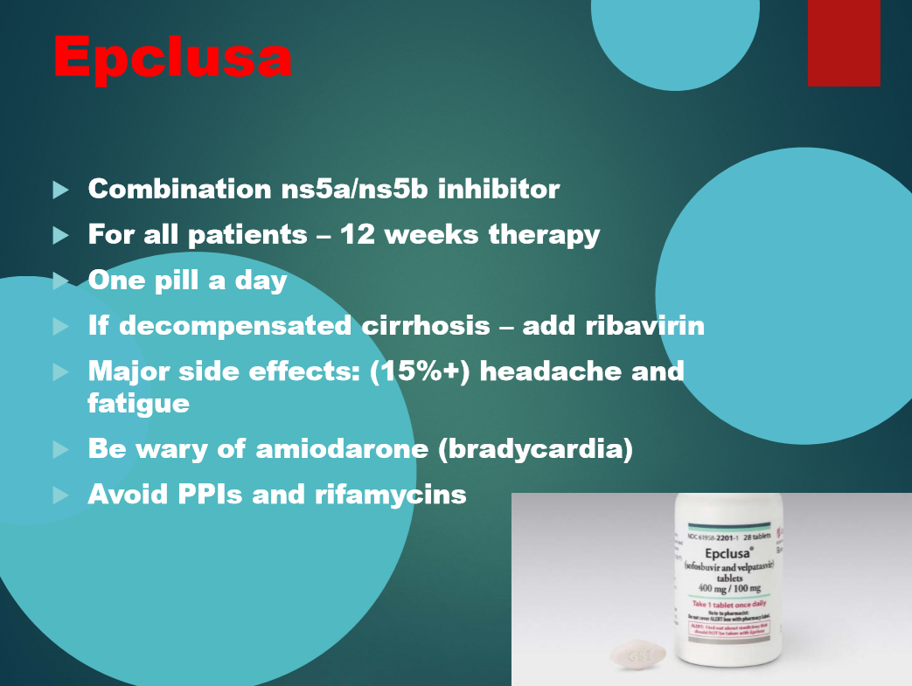
Sofosbuvir/Velpatasvir
GT1-6
No cirrhosis or compensated cirrhosis: 12 wks
Drug-Drug Interactions
PPI
Amiodarone
Anticonvulsants
Various herbals
Rifampin

Slide 36
Pretreatment Considerations
Is patient a candidate for Simplified Treatment?
Look for potential drug–drug interactions
  Review all herbals/supplements, prescription and OTC meds, including contraceptives and proton pump inhibitors
  Ask about PRN usage of other drugs
  Consult with clinical pharmacist when possible
  Key Resource: Liverpool drug-interaction checker
No reason to withhold therapy from PWID
Notes:
App on smartphone called Hep I- Chart from university of Liverpool.
St. Johns Wort- not okay to take with treatment
Other drugs to look for reactions

Slide 37
Is patient a candidate for Simplified Treatment?
Yes Unless
  Prior hepatitis C treatment
  Cirrhosis (F4 on FibroSURE)
    But there is a rubric for patients with compensated cirrhosis
  HBsAg positive
  Current pregnancy
  Known or suspected hepatocellular carcinoma
  Prior liver transplantation

Slide 38
Is patient a candidate for
Semi-Simplified Treatment?
(with complicated cirrhosis)
Yes Unless
  Decompensated cirrhosis (ever)
    Child-Turcotte-Pugh score ≥ 7
  Prior hepatitis C treatment
  End-stage renal disease (eGFR < 30)
  HBsAg positive
  Current pregnancy
  Known or suspected hepatocellular carcinoma
  Prior liver transplantation

Slide 39
If patient isn’t a candidate
Recruit a consultant who will collaborate
  Hepatologist
  Infectious disease specialist

Slide 40
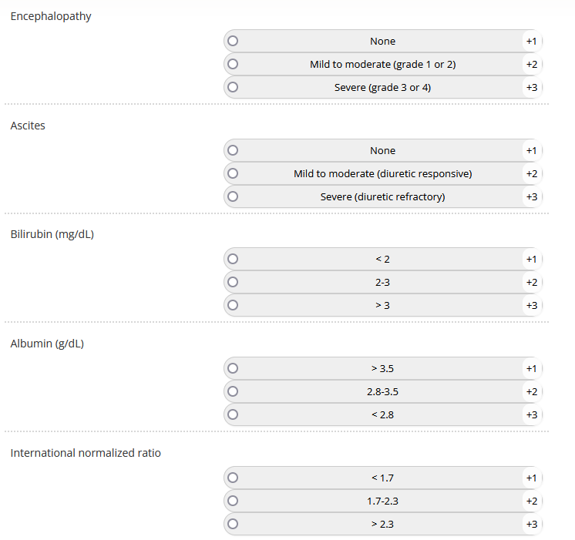
Child-Turcotte-Pugh score
Calculator: https://www.hepatitisc.uw.edu/page/clinical-calculators/ctp
Score | Class
5-6 | A
7-9 | B
10 | C

Slide 41
Treatment Monitoring
If on medication for diabetes mellitus: monitor for hypoglycemia
If on warfarin: monitor for subtherapeutic anticoagulation
No laboratory monitoring is required for other patients

Slide 42
Test of Cure
≥ 12 weeks after end of therapy
RNA Undetectable
  = virologic cure
  If liver function tests remain abnormal ➔ Rule out other causes of liver disease
RNA Detectable
  ➔ Refer for further care

Slide 43
Followup of SVR
(avoid alcohol)
If patient is at ongoing risk, test RNA annually
  The rate of reinfection in the PWID population is low
Otherwise, no followup needed
Patients without cirrhosis appear not to need HCC surveillance
  If they did, it would be with ultrasound, not alpha-fetoprotein

Slide 44
Follow-Up of SVR Patients
SVR12
(baseline F0/F1)
SVR12
(baseline F2/F3)
SVR12
(baseline F4 [cirrhosis])
Post-SVR
Week 48
Post-SVR
Week 48
Post-SVR
Week 48
HCV RNA
Non-Invasive Tests
HCV RNA
Non-Invasive Tests
HCV RNA
PWID, MSM
Alcohol, Obesity, Diabetes
No
Yes
Non-Invasive Tests
Every 12 Months
Liver Ultrasound
Every 6 Months
HCV RNA
Every 12 Months
Lifestyle Changes
Diabetes Control
Liver Biopsy if
Elevated ALT/AST
Serfaty L, et al. Liver Int. 2016;36(suppl S1):67-71.

